Slide 1
CDR Presentation
Group 16: Quentin Morton, Jasmin Chadha, Heng Deng and Ajay Dhindsa
Notes:
Jasmin

Slide 2
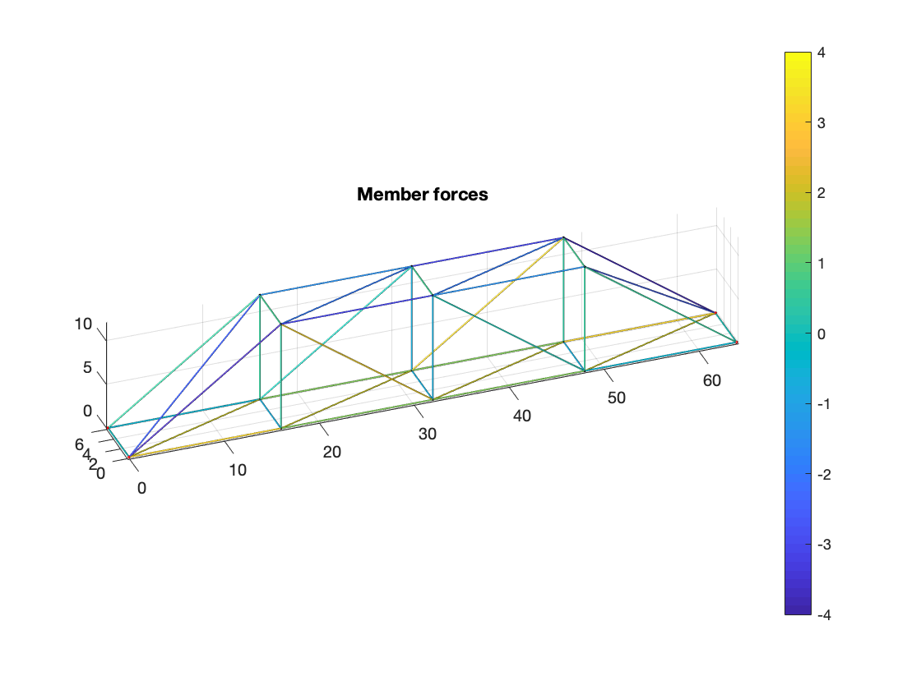
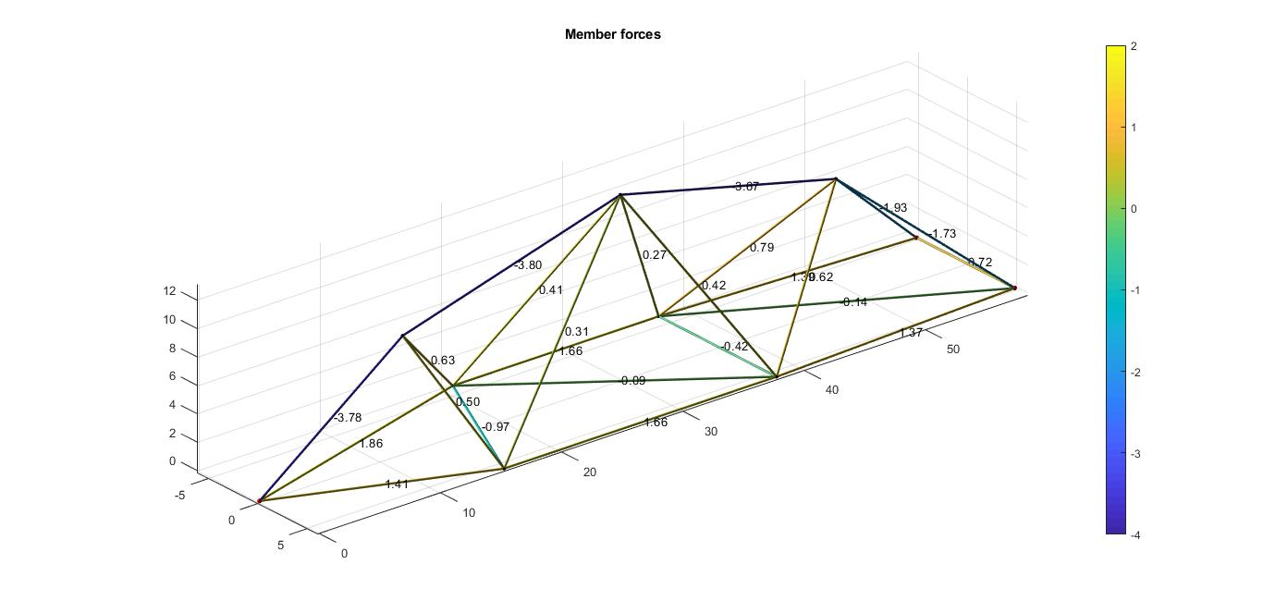
Information about models
-The first design sits on two rails and two pads, the second on three rails
-External forces are reaction forces and weight of the truss, applied at each joint
Notes:
Quentin / images from Ajay
-Talk about supports, mention friction from pads, external forces are reaction forces at supports and weight

Slide 3
Down Selecting Design
Length
Probability of failure
Analysis of track record

Slide 4
Layout and Analysis of Designs
6 Reactional force components
Two reaction forces at each of three rails.
Self-weight applied on each joint
Mass of joint ball is 8.36 g.
Mass of bar per unit length is 1.214 g/inch.
No external weight

Slide 5
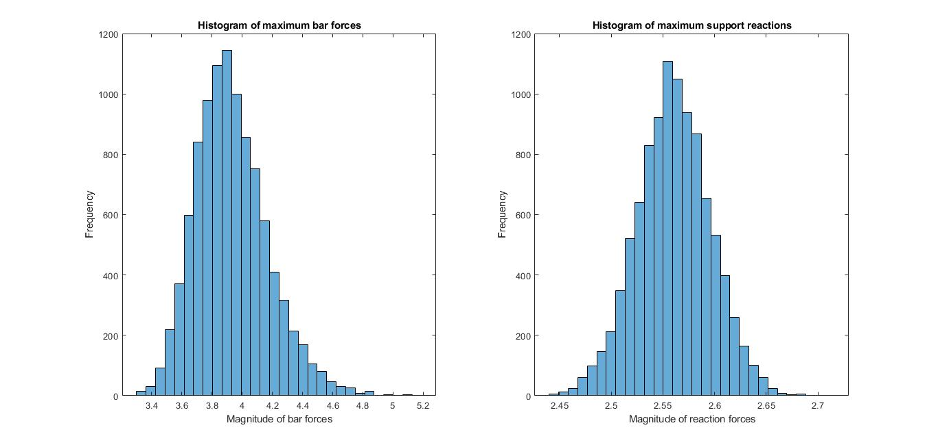
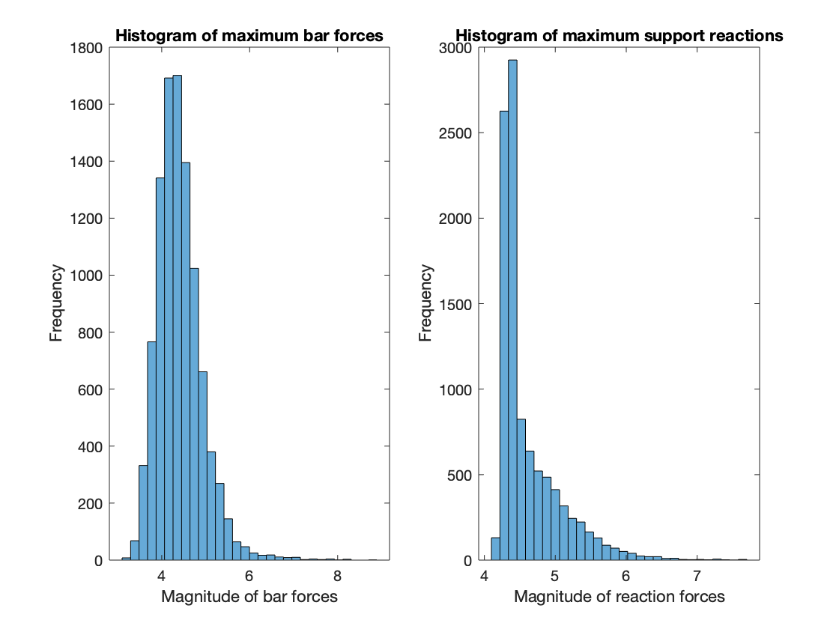
Safety Factor
The Factor of Safety calculated for the chosen design is 1.13 which is within the usual safety factor of aerospace designs of 1.0 - 1.8
Chosen design
Other design
Notes:
Ajay

Slide 6
Sensitivity Analysis for selected design
For the chosen design, the design force was calculated to be approximately 3.8 N using a probability of failure of 3.05%. The rationale for choosing this design over the other design is that this design is significantly less likely to fail and .
Notes:
Ajay

Slide 7
Materials needed for construction
22” x 1 12” x 6 Sleeves - 6
18” x 1 10” x 16 Joints - 10
16” x 3 8” x 16
14” x 2 6” x 10
Notes:
Quentin

Slide 8
References
https://usbridge.com/through-truss-steel-bridges-optimal-design/

